Slide 1
Advanced Business
Circulation Documenter

Slide 2
The Reason why BlockChain is Used
Transparency
Traceability
Anyone in the network
can see and verify the data
Anyone in the network
can trace the history of data
Immutability
Decentralization
If the system is well designed,
it’s hard to modify and exploit
Reliability can be maintained
even if there’s no
suitable intermediary agent

Slide 3
Structure of Block
Transaction
Fundamental data storage
Merkle Root
Hash value of these TXs
Block Hash
Hash value with MR, Nonce, timestamp, etc.
Previous Block’s Hash
Using like a linker in Linked List
Previous Block’s Hash
Nonce
Block hash
Merkle Root
TX1
TX2
TX3
…

Slide 4
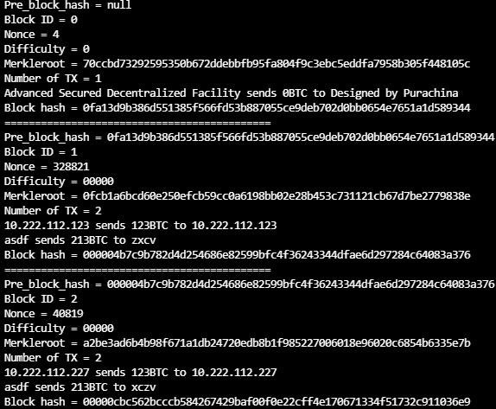
Structure of BlockChain
null
0fa13d9b3
0000004b7c
4
0fa13d9b3
328821
000004b7c
40819
00000cbc5
70ccbd732
0fcb1a6bc
a2be3ad6b
TX1
TX1
TX2
TX1
TX2

Slide 5

How to Maintain Integrity
Hash
must
be
LESS
THAN
00100000
00000abcd
7
6
9
8
5
741852963
888777ccc
fffeeeddd
10
999123456
3
999000111
4
2
0
1
000ffffff
aaa333888
123987abc
987654321
abcdef012
aaabbbccc
Merkle Root
TX1
TX2
TX3
…
A
A’s Block Status
(PBH, MR, Timestamp, …)
String hash(Object o) {…}
000ffffff
10

Slide 6

How to Maintain Integrity
B
B’s Block Status
(PBH, MR, Timestamp, …)
String hash(Object o) {…}
000ffffff
10
C
C’s Block Status
(PBH, MR, Timestamp, …)
String hash(Object o) {…}
000ffffff
10

Slide 7
How to Maintain Integrity
00000abcd
000ffffff
10
999888abc
0
000ffffff
0
fed987002
3
999aaafff
4
2
5
999000111
0
1
aaa333888
123987abc
987654321
abcdef012
aaabbbccc
aaabbbccc
123456789
fff123aaa
abcdef123
TX1
TX2
TX3
FTX
…
TX1
TX2

Slide 8
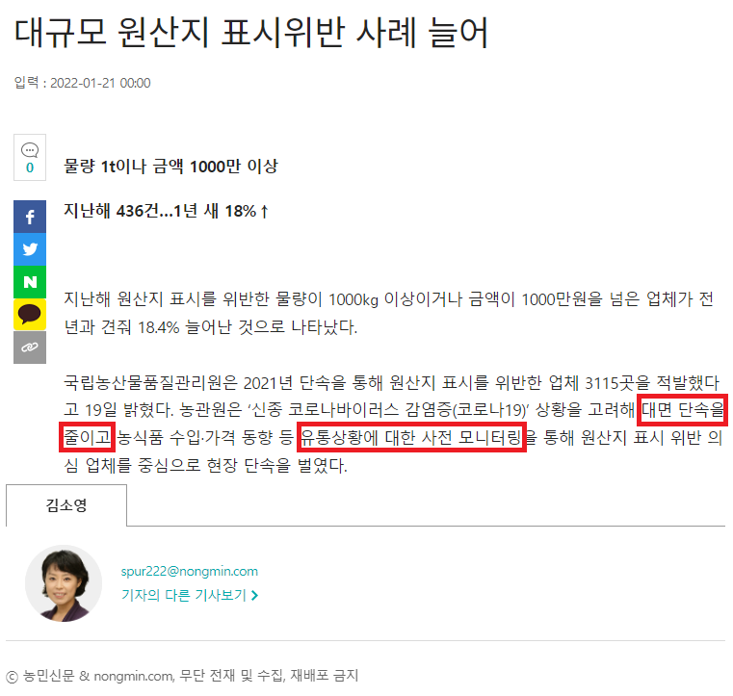
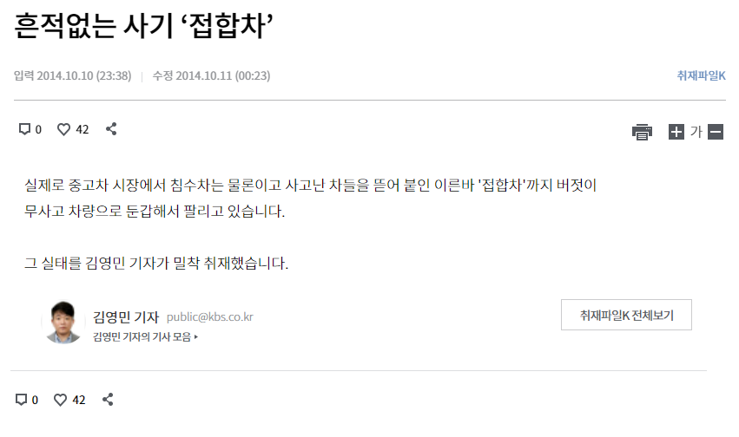
Feasibility of the ABCD

Slide 9
Feasibility of the ABCD
Good
Bad
Have little advantage to cheating
Considering Brand value, Justification
Easy to monitor
Often happens in B2C
One-time transaction that difficult to build reliability
Difficulty to control because there’re many small point

Slide 10
How the ABCD Works
Good
123456789
abcdef012
123456789
aaabbbccc
abcdef012
123456789
aaabbbccc
000111222
abcdef012
123456789
aaabbbccc
000123456
abcdef012
aaabbbccc
000987654
000abcdef
abcdef012

Slide 11

Scenarios of Fraud
Good
Hash value
invalid!!!
aaabbbccc
Made in Korea
Made in China
123456789
abcdef012
123456789
aaabbbccc
000111222
abcdef012
123456789
aaabbbccc
000123456
abcdef012
aaabbbccc
000987654
000abcdef

Slide 12
Scenarios of Fraud
Manipulated N
PBH
invalid!!!
000111222
Made in Korea
Good
123456789
abcdef012
123456789
aaabbbccc
abcdef012
123456789
aaabbbccc
000123456
abcdef012
aaabbbccc
000987654
000abcdef
000333444

Slide 13
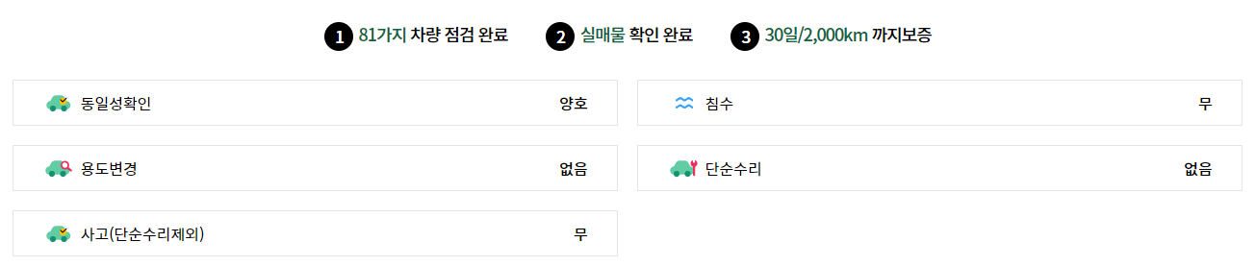
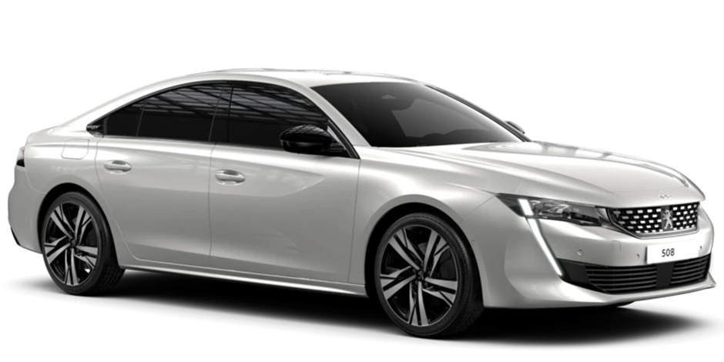
Scenarios of Fraud
! ! !
Prod date
20220302
Repair: 0
Prod date
20210404
Repair: 0
Prod date
20210404
Repair: 0

Slide 14

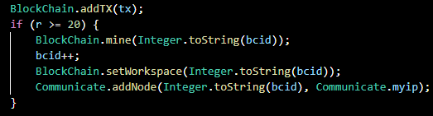
Simulating the Real-World
~Manufacturer Phase
Door 2 BlockChain
Door 1 BlockChain
cccddd
000fff
aaabbb
123456
987654
abcdef
Door ID: 2
Door ID: 1
TX
TX

Slide 15
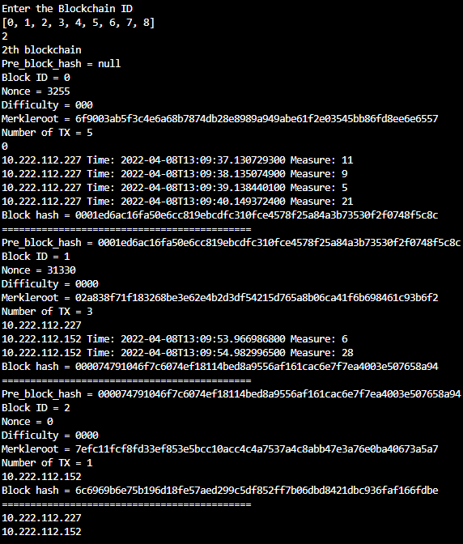
Simulating the Real-World
~Third-party Phase
Door ID: 1
(Recognized via
Barcode, QR Code, etc.)
Block which contains
Manufacturer(227)’s TX
(Mined by Manu.)
Requests Door 1’s BlockChain
(Recog IP via Barcode, QR Code, etc)
Where
the Pre-Block
came from
Block which contains
Service Center(152)’s TX
(Mined by Serv.)
Door 1 BlockChain
Block to lock
the previous block
& add TX for next section
(Not mined yet)
000123
000fff
aaabbb
000123
123456
aaabbb
987654
abcdef
cccddd
fff123
cccddd
fff123
TX
TX
TX
Nodes who
has this BlockChain
(Can use for Valid, Req B.C., etc)
TX

Slide 16
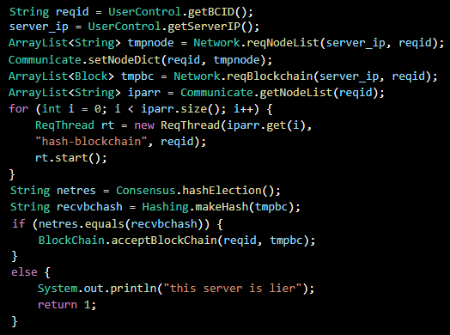
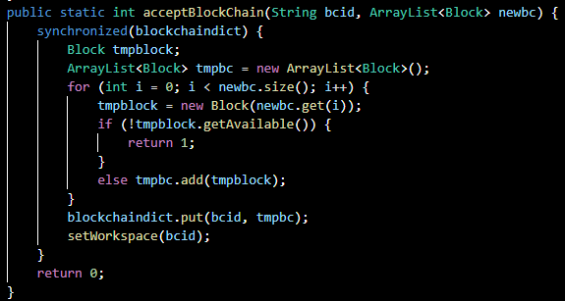
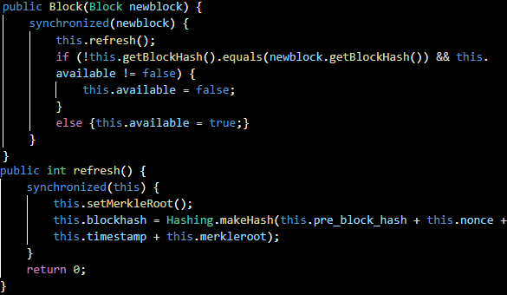
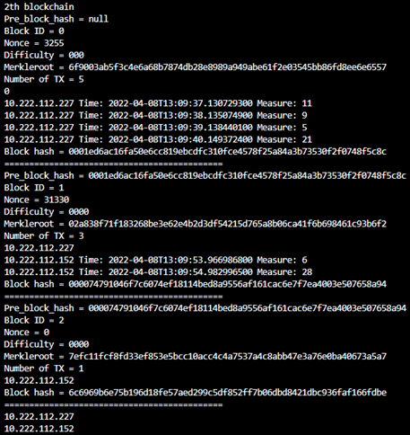
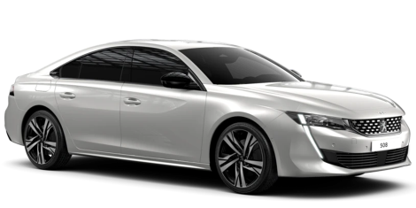
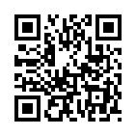
Simulating the Real-World
~Customer Phase
String hash(Object o) {…}
abc123456
Nodes who has Door n’s BC
[123, 456, 789]
String hash(Object o) {…}
abc123456
123
789
Req
Nodelist
456
(Contains
B.C. ID,
Address to
send Req)
abc123456
String hash(Object o) {…}

Slide 17
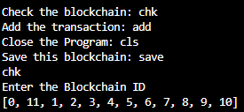
Overall Bird’s Eye View
Basically,
Manufacturer has
all the BlockChains
in this model
Door 1 Network
Door 2 Network
000fff
000123
123456
987654
abcdef
aaabbb
cccddd
fff123
000aaa
999789
TX
TX
TX
TX
TX

Slide 18
Advantages of ABCD
Manufacturer(i.e. Hyundai, Monsanto, etc.)
Collecting Data for Product Development/Improvement
Maintaining Brand Reputation/Product Quality
Effective Logistics System Management
Third-party(i.e. Service Center, Food Supplier, B2C/B2B Broker, etc.)
Ease of Understanding the Situation
Maintaining Customer Trust
Customer(i.e. Individuals, Corporations, etc.)
Less Worry about Reliability
Potential Cost Reduction(Research for Authenticity)

